Slide 1
Recurrent Neural Networks
Stock Price Prediction
E
presented by
Cecilia Tipping

Slide 2

Project Overview
E
Goal: Compare LSTM and GRU for predicting AAPl stock prices
Ivestigate how additional factors (Volume, OHLC) impact prediction performance
Experiment with activation functions in GRU (ReLU, LeakyReLU, ELU)
Evaluate models based on RMSE and behavior during training

Slide 3
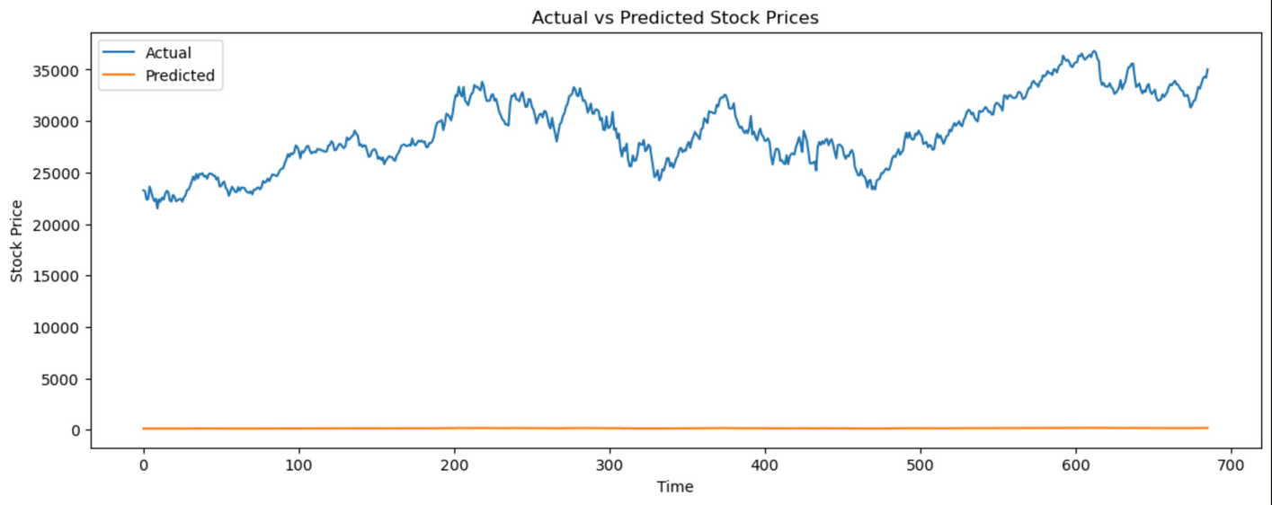
E
LSTM struggled → produced flat and non-informative predictions
Close-only dataset too limited → LSTM failed to converge meaningfully
GRU handled limited data better → followed price trends, though accuracy was modest
Reinforced need for more context (features) for models like LSTM
Model Observations
LMST (Close only)

Slide 4
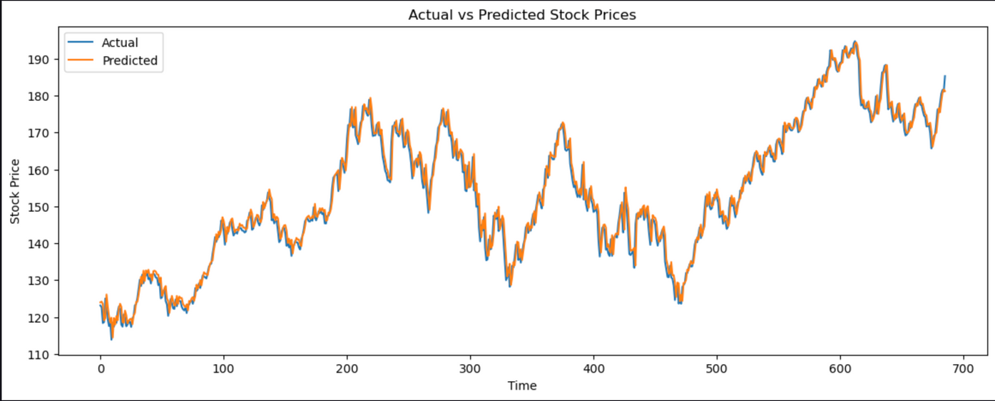
E
GRU (Close only)
Model Observations
LMST (Close only)

Slide 5
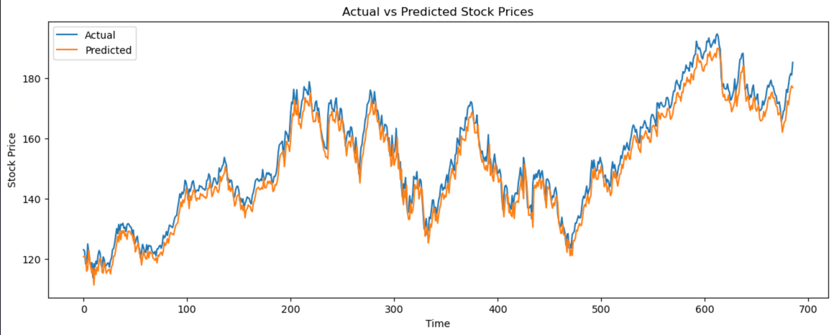
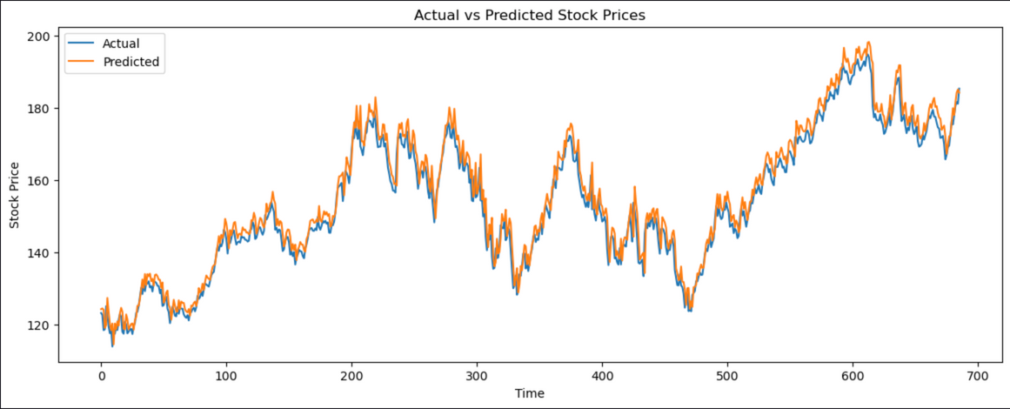
E
Adding Volume
Adding Volume improved prediction quality for both models
GRU became much more responsive and closed the performance gap
LSTM also performed very well, possibly matching or slightly outperforming GRU at this stage.
GRU (Close + Volume)
LSMT (Close + Volume)

Slide 6
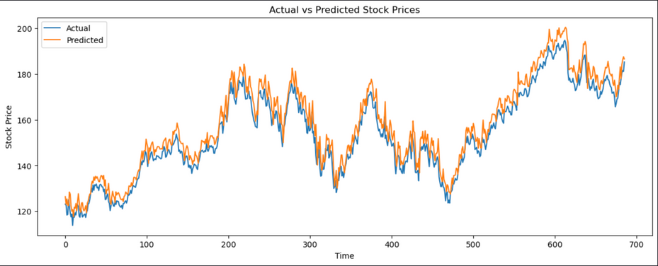
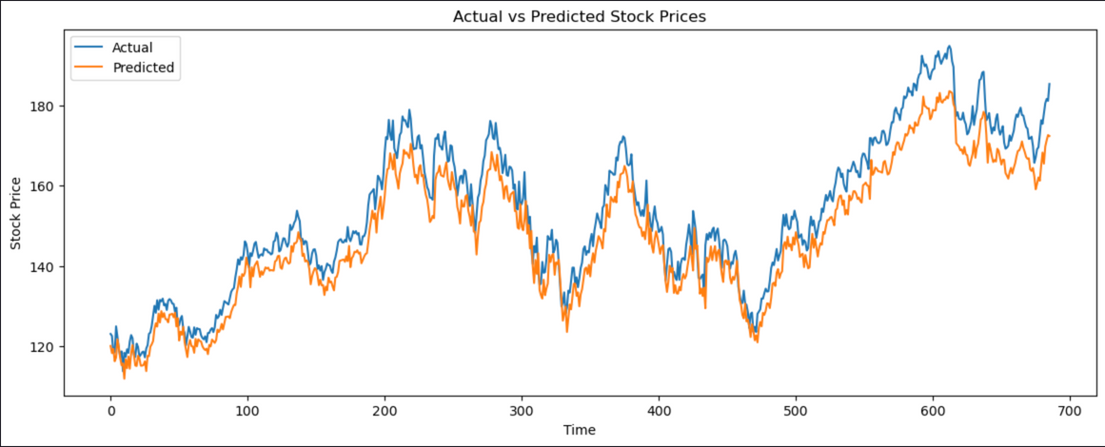
E
OHLC + Volume → GRU Takes the Lead
Adding OHLC introduced richer feature set → GRU handled this complexity better
Adding OHLC introduced richer feature set → GRU handled this complexity better
LSTM was still competitive, but GRU showed its scaling advantage
LSMT(Volume + OHLC)
GRU(Volume + OHLC)

Slide 7
E
ReLU
Tracked overall trend but consistently underpredicted stock prices.
LeakyReLU
Slightly improved tracking over ReLU but still fell short of actual prices.
ELU
Best performer, closely following actual prices with smaller gaps.
GRU Activation Function Experiments
Conclusion →
ELU activation offered the most accurate and stable predictions overall.

Slide 8
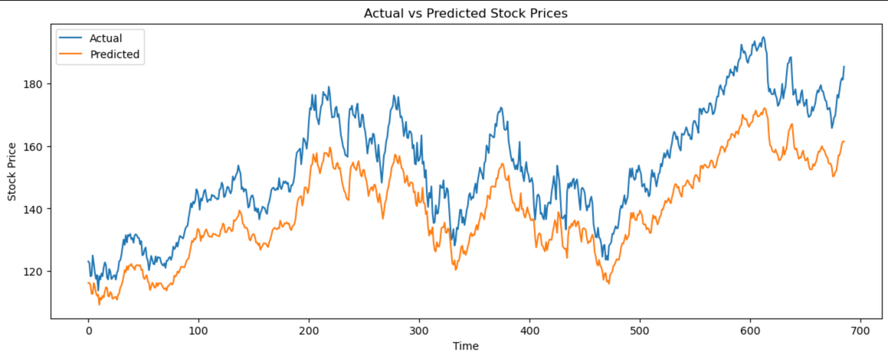
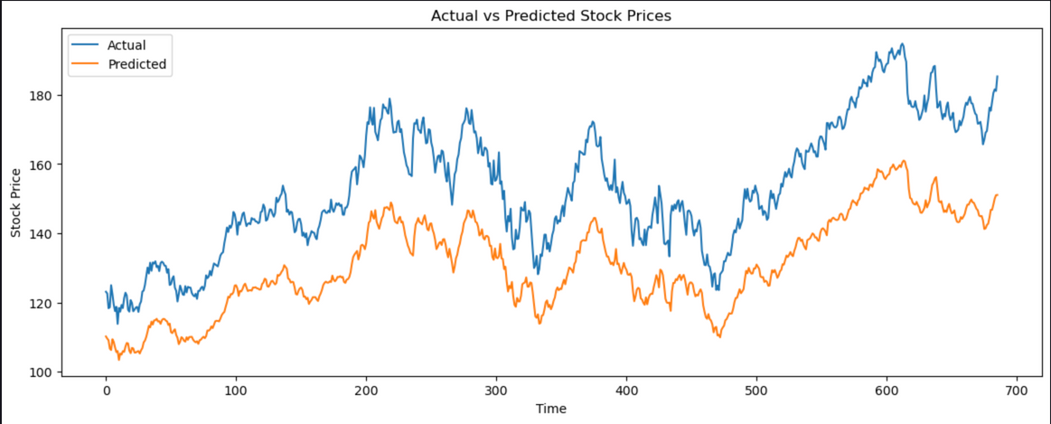
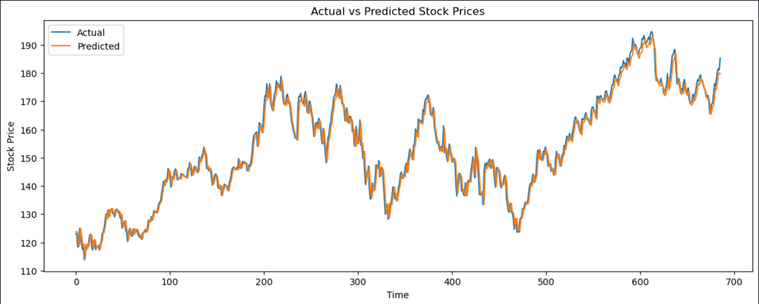
E
ReLU
GRU Activation Function Experiments
LeakyReLU
ELU

Slide 9
E
Challenges Encountered
Input shape management became more difficult as features were added
LSTM’s inability to handle Close-only highlighted risks of underfitting with limited data
Activation experiments → small tweaks had large effects on training stability
psutil + TensorBoard helped monitor efficiency during experiments

Slide 10
E
LSTM
better suited for more complex patterns, but requires sufficient input data
GRU
more flexible and adaptable, especially as input complexity increases
LeakyReLU
Feature selection was critical → more data helped, but only when used thoughtfully
best activation function tested → stable, fast, and consistent
Key Insights and Takeaways

Slide 11
E
Future Directions
Test models on other stocks for generalization
Add external market indicators (ex: sentiment analysis, macroeconomic signals)
Explore alternative architectures like Transformers for further improvements

Slide 12
E
Final Reflection and Questions
Subtle, but important differences emerged across experiments
LSTM and GRU both viable, but GRU proved more flexible overall
Future modeling success depends on carefully balancing architecture, features, and tuning

Slide 13
Thank you!
CS5393
Cecilia Tipping
E

